Slide 1
What is a black hole?

Slide 2
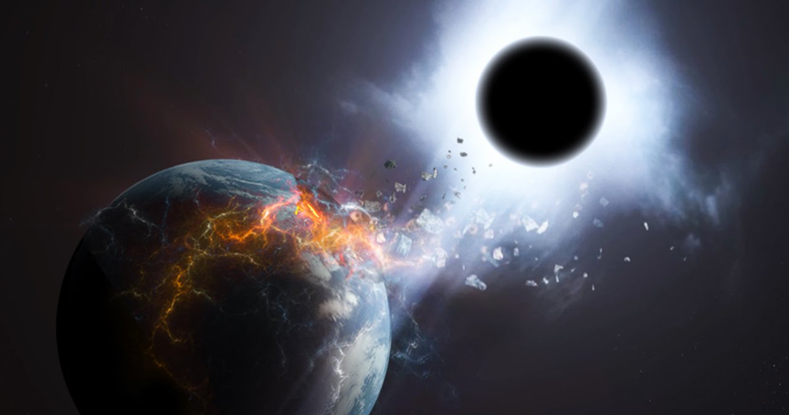
Myth or Fact?
Credit: Peter & Trent Ninos
Notes:
Refer to Activity sheet: Introduction part (Step 1).

Slide 3
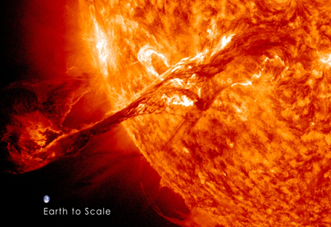
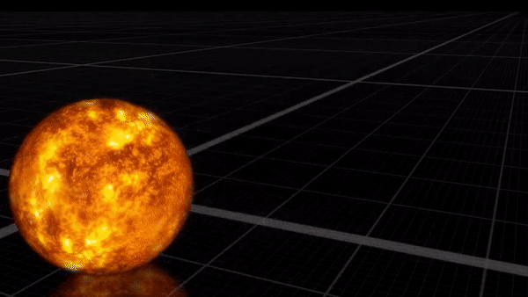
Black hole - enormous mass
Mass: 3 to billions of Suns
Credit: NASA
Credit: NASA
Creative Commons
https://creativecommons.org/licenses/by/3.0/
Notes:
Refer to Activity sheet: Introduction part (Step 2) and background information
https://www.youtube.com/watch?v=QgNDao7m41M

Slide 4
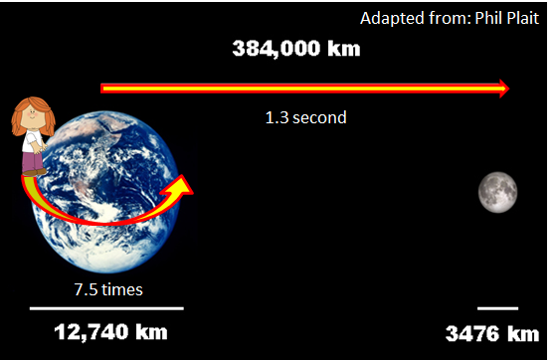
What is a black hole?
Powerful gravity
Even light cannot escape
Credit: NASA
Notes:
Refer to Activity sheet: Introduction part (Step 2) and background information
https://www.youtube.com/watch?v=hu6hIhW00Fk
Black hole is a region in space where the pull of gravity is so strong that nothing can escape. Not even light can escape from black hole, although it moves the fastest in space. Light only takes 1.3 seconds to go from the moon to the Earth. And if we moved at the speed of light, we could run around the Earth 7.5 times just in one second. That is how strong the pull of gravity in a black hole can be.

Slide 5
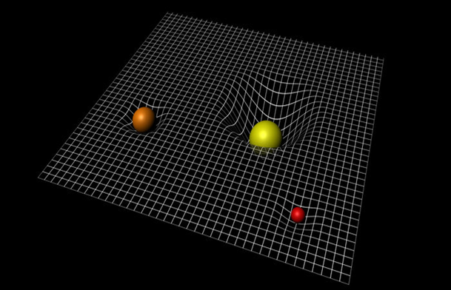
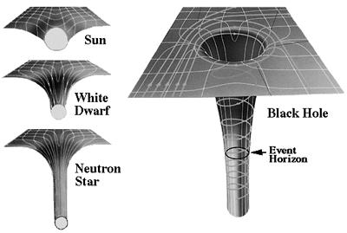
Do you really know gravity?
Space
Mass
Bending
Newton
Einstein
Notes:
Refer to Activity sheet: Background information, Introduction part (Step 3, 4). Second photo on the right (black hole, Sun) is for Activity 4 (step 8).
http://wallpapersafari.com/w/NAUQsV

