Slide 1
Hunting for a black hole

Slide 2
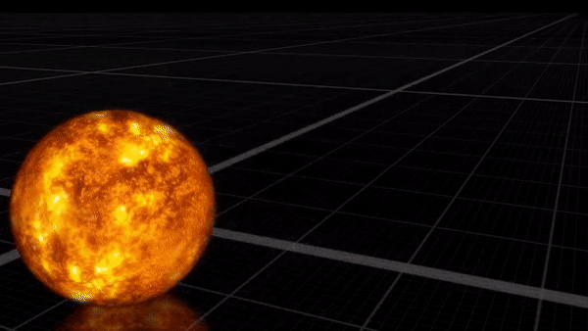
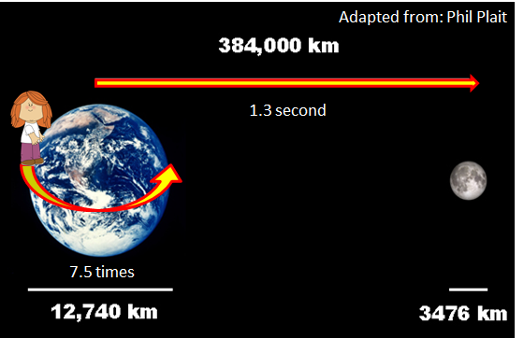
What is a black hole?
Powerful gravity
Mass - 3 to billions Suns
Even light cannot escape
Observation?
Creative Commons
https://creativecommons.org/licenses/by/3.0/
Notes:
Refer to Activity sheet: Introduction part and Background information.
https://www.youtube.com/watch?v=QgNDao7m41M

Slide 3
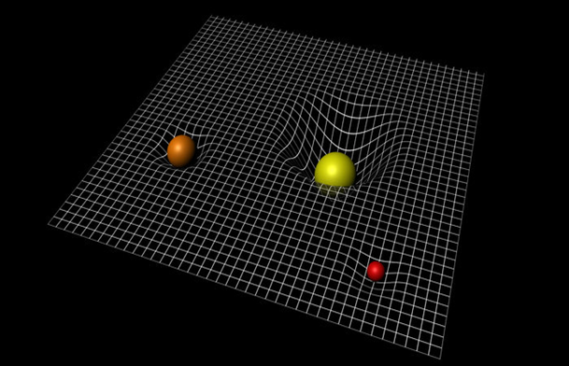
Do you really know gravity?
Space
Mass
Bending
Newton
Einstein
Notes:
Refer to Activity sheet: Background information and Activity 1 (Gravity).
http://wallpapersafari.com/w/NAUQsV

Slide 4
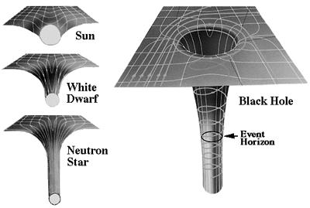
Watching a black hole eat
Credit: NASA
Notes:
Refer to Activity sheet: Background information and Activity 2 (step 3).
https://www.youtube.com/watch?v=hu6hIhW00Fk

Slide 5
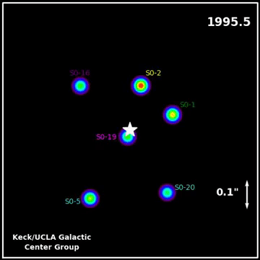
What if the black hole isn’t eating?
Black hole as ☆
Notes:
Refer to Activity sheet: Background information and Activity 3 (step 5). Other stars orbit around the black hole (denoted ☆), they never go straight across the area of ☆, only bounce back or orbit around.
https://www.youtube.com/watch?v=A2jcVusR54E

Slide 6
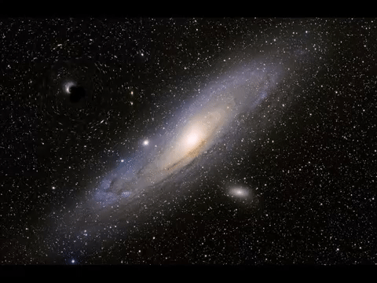
Watching a black hole bend light
Notes:
Refer to Activity sheet: Background information and Activity 4 (step 5). As a black hole passes in the foreground of a galaxy, it distorts the image of the galaxy that we observe from the Earth.
https://www.youtube.com/watch?v=y30bsSuTAIo

