Slide 1
The invisibles of the Universe
Dark matter & Dark energy

Slide 2
What is known in our Universe?
https://www.youtube.com/watch?v=17jymDn0W6U
Notes:
Refer to Activity sheet Part 1- Activity 3 (step 2).

Slide 3
The known universe
•Stars, planets
•Galaxy
•Galaxy clusters
•
• Is there invisible matter?
Notes:
Refer to Activity sheet Part 1, Introduction part (step 2-5).

Slide 4
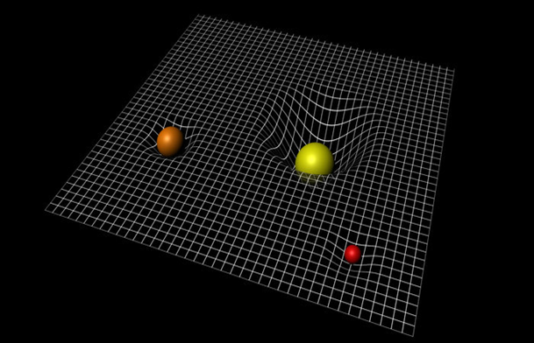
Do you really know gravity?
Universal glue
Space
Mass
Bending
Newton
Einstein
Notes:
Refer to Activity sheet Part 1 - Background information and Activity 1 (gravity).
http://wallpapersafari.com/w/NAUQsV

Slide 5
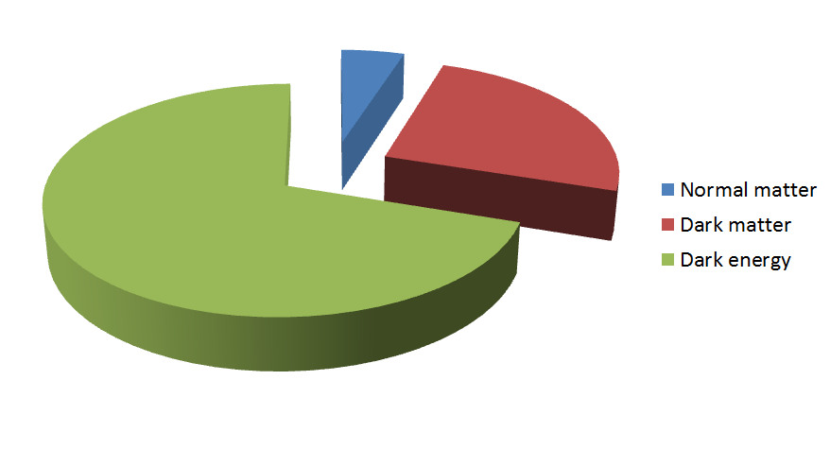
What is the Universe mainly made of?
Notes:
Refer to Activity sheet Part 1- Activity 3 (step 1).

Slide 6
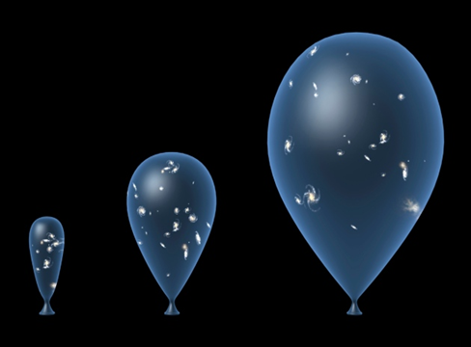
Dark Energy
•Invisible
•Opposite of gravity
•Only theories
Notes:
Refer to Activity sheet Part 1- Activity 3 (step 2).

Slide 7
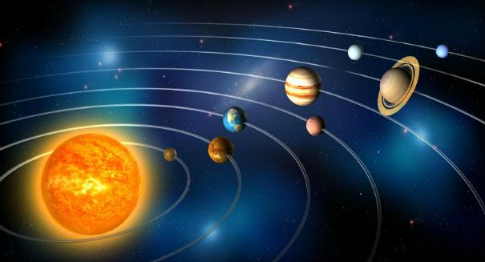
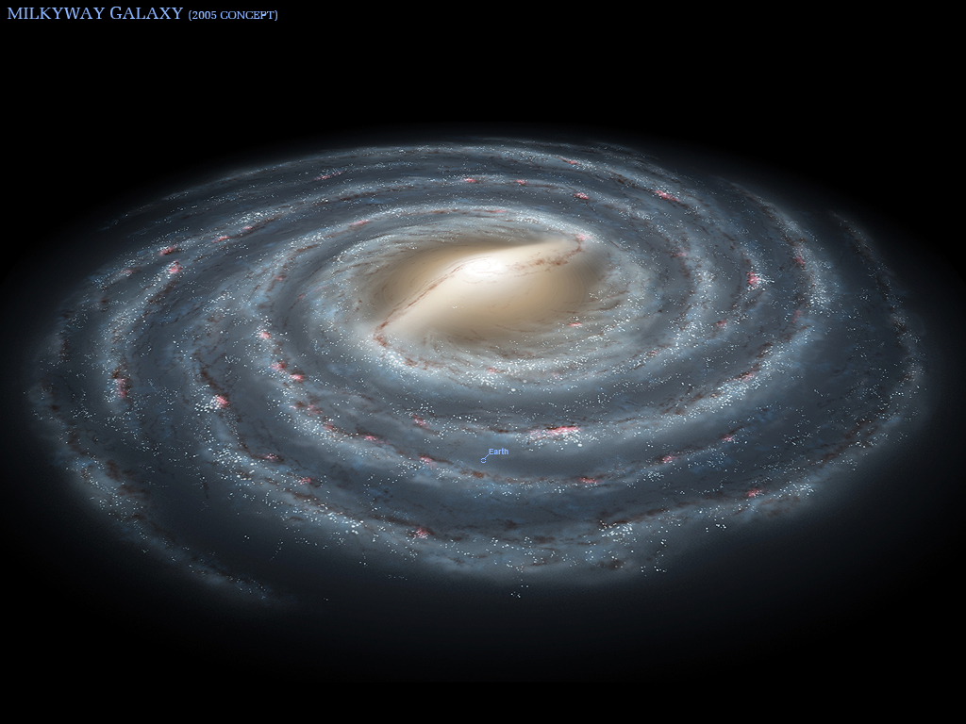
Finding more proof of Dark Matter
Solar system
Galaxy
Notes:
Refer to Activity sheet Part 2 - Activity 1 (step 3-6).

Slide 8
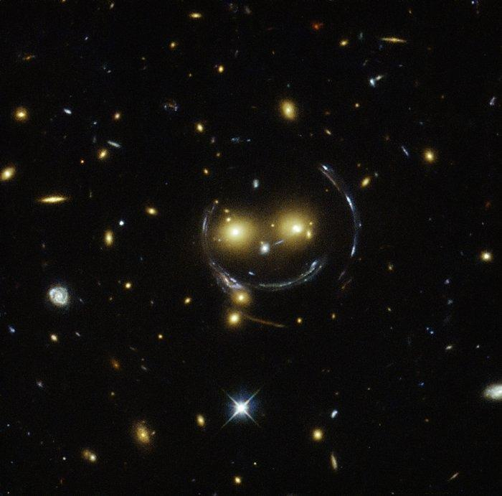
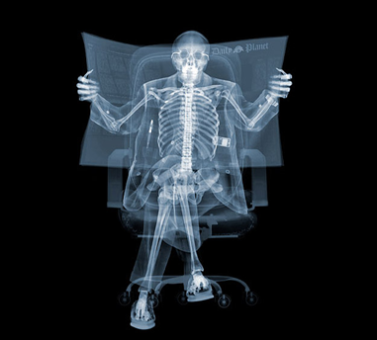
Dark Matter
•Invisible mass
•Gravity for universe
•Only theories of what it is
Credit: NASA & ESA
Credit: Nick Veasay
Notes:
Refer to Activity sheet Part 2 - Activity 2 (step 4), image of gravitational lensing. Then, at activity 3 (step 4), click to change image.

